Slide 1
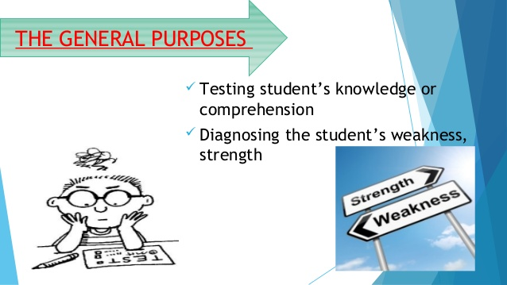
Objective Test Items Kishore Kumar Biswal Associate Professor, HCE,Gangtok 17/08/2018

Slide 2
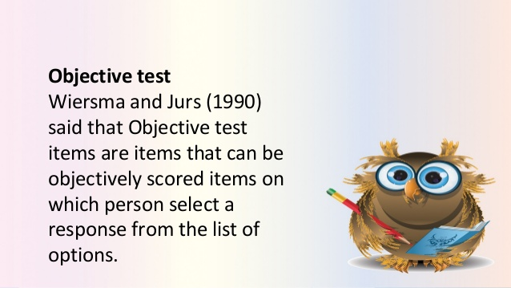
TEST ITEMS

Slide 3
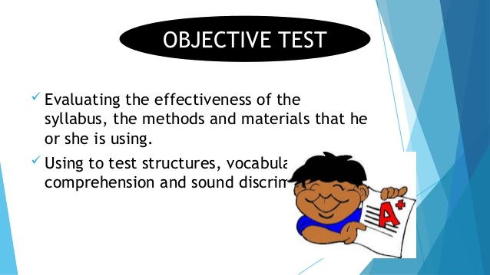
TEST ITEMS

Slide 4
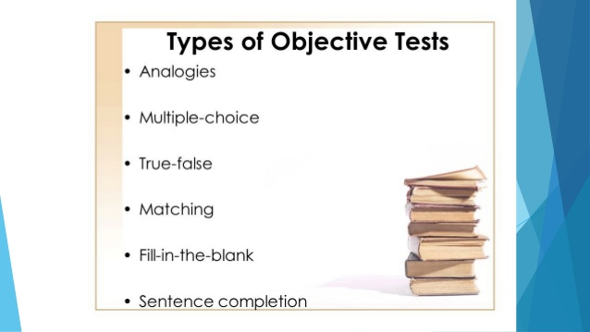
TEST ITEMS

